Slide 1
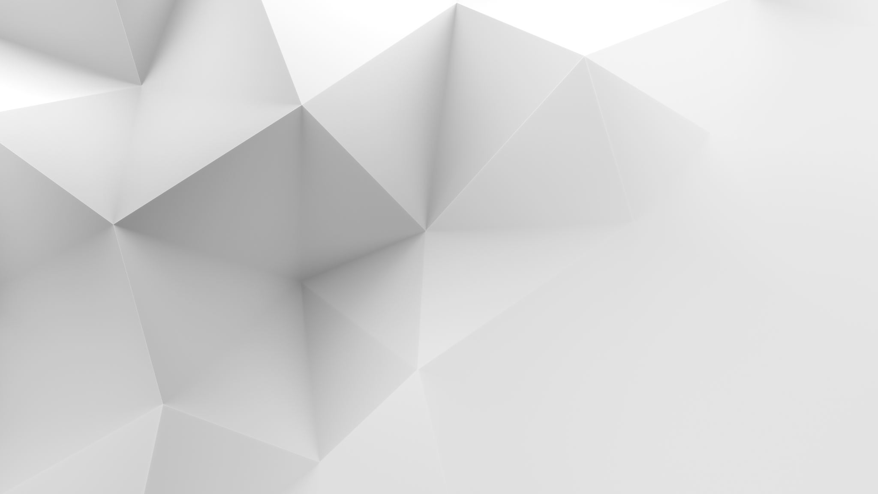
Progress of: Cavebound Final year Project - Game
Year 4 - Computer Games development
Andrew Greenslade – C00246189

Slide 2
Background story of Cavebound
The game, Cavebound is set in a different universe in the year 2042, where big corporations hire miners to drain a planets resource’s (ores) for money.
Your goal is to mine the most ores in a set amount of time and store them in your mining ship.
You can also choose to allow others to do this and steal their resources by eliminating them.
The game is set on different planets that all have different themes and random world generations.

Slide 3
What is Cavebound?
Cavebound is a 2D side scrolling Mining game that features:
Online mining PVPVE gameplay (Player V Player V Environment)
Blockchain integration: fortune wheel spin earned by winning a game/achievements earning.
Achievements: custom achievement system that rewards the player.
Different Planet types: Planet types like earth, Hoth (Ice), Mustafar (Lava/scorched earth), etc.

Slide 4
Why I picked this as my F.Y.P (Final Year project)
I picked this as my FYP (final year project), for some of the following reasons:
I could get a proper insight into how to make a multiplayer networked game,
I could learn about cryptocurrencies and how they integrate into gaming and games development in their current form as well as how they may shape gaming in the future,
I am using technology's (2D tile-sets, Perlin noise, etc.) to help promote myself to use existing technology's in creative and different ways e.g. simple and effective 2D underground level generation.
To encourage myself to not be afraid to experiment with new technology's like blockchain and rendering pipelines.

Slide 5
Features I have implemented so far
Level generation
Player spawn room generation
Player spawning
Unity’s new input system
Proof of concept Lobby system
Unity’s URP (Universal Rendering pipeline) & 2D lighting

Slide 6
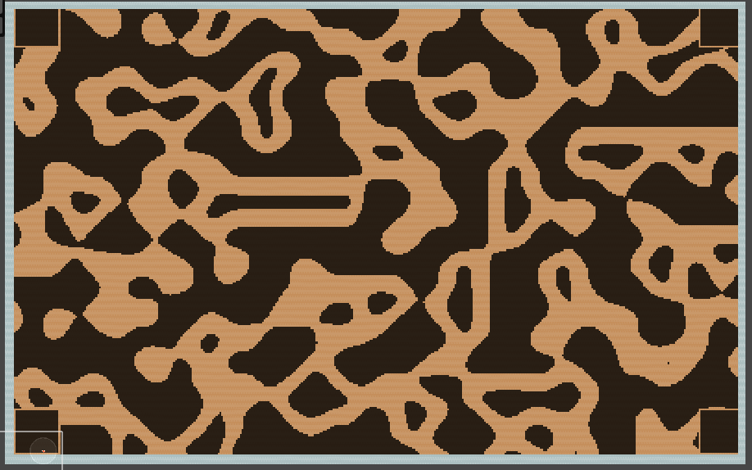
Images of current Implementations:
Map generation
Shows the current map generation along with the players spawn rooms, and a border
Each corner has a ‘spawn box’

Slide 7
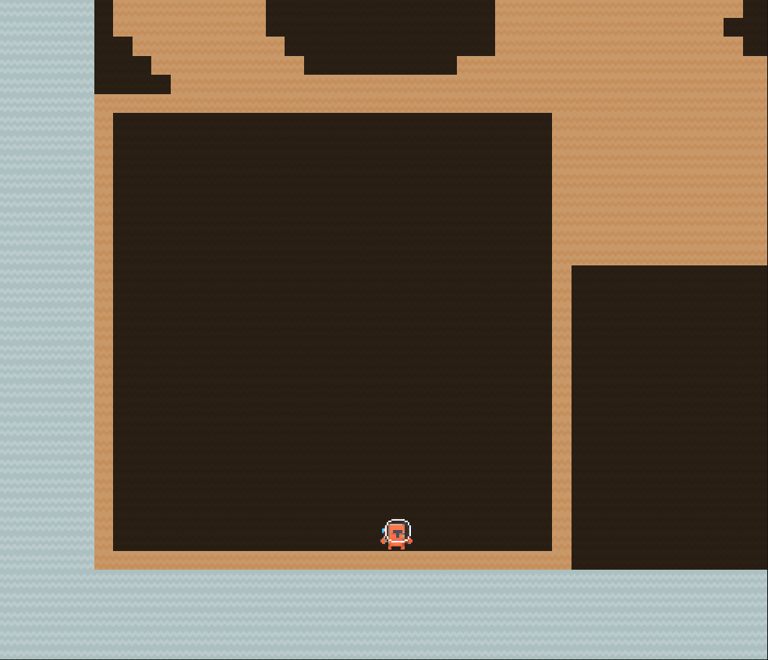
Images of current Implementations:
Spawn Box
This will be each players safe space, where they can spawn and have a safe shield (not implemented yet) that will keep them safe while they are in it to combat spawn trapping

Slide 8
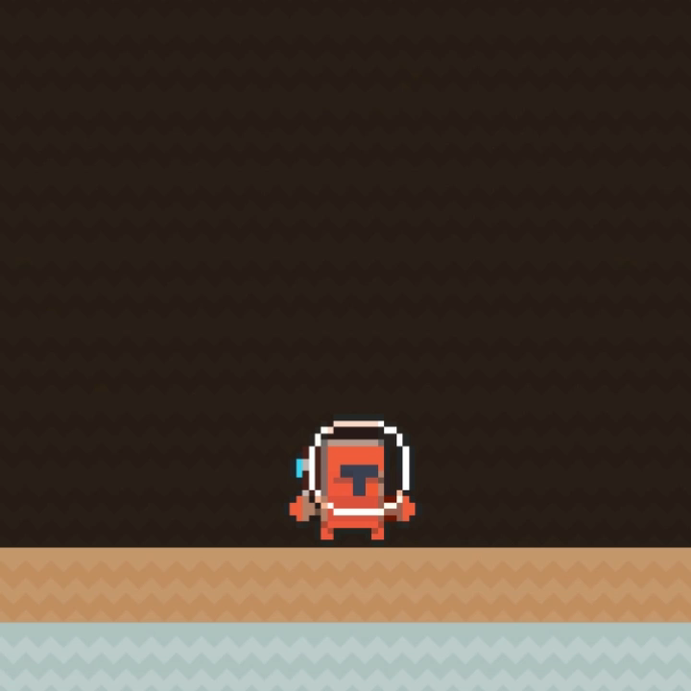
Images of current Implementations:
Input system
The player will be able to be controlled with a variety of different input devices, such as keyboard and mouse or controller.
This will be done using unity's new input system and unity events.

Slide 9
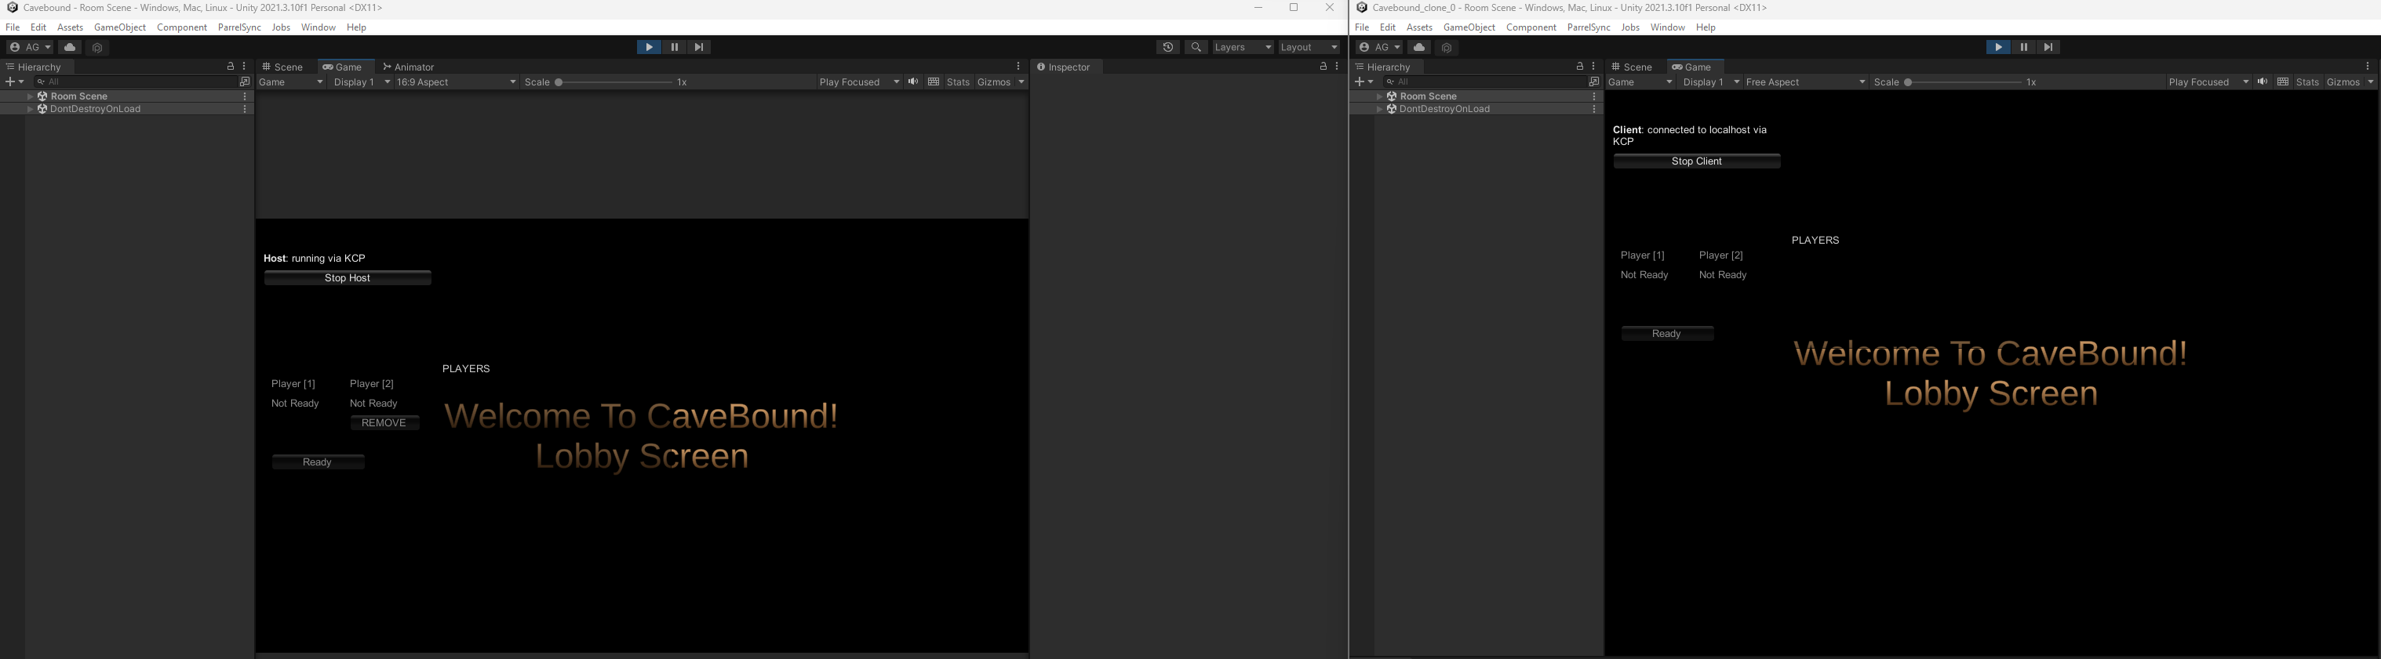
Images of current Implementations:
Proof of concept lobby system
Shows two clients, one acts as a host , the other a client of that host
The host can remove the second client if they wish.

Slide 10
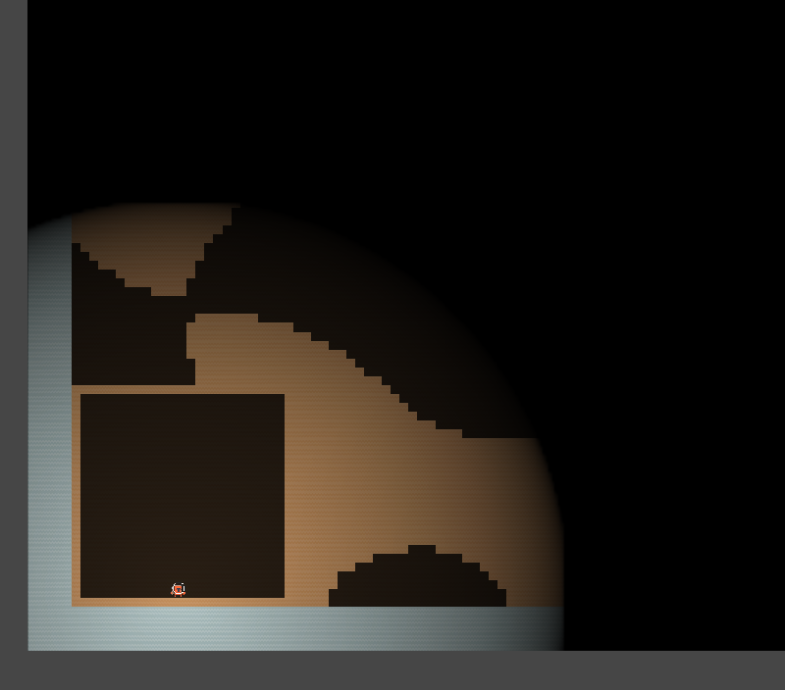
Images of current Implementations:
URP & 2D lighting
I have implemented URP and in particular 2d lighting to give a sense of ambiance and allow them to believe they are underground and lost

Slide 11
Any questions ?

